Slide 1
Club Competition Subjects
Feb & Aug Open - Any subject or topic of the photographer’s choice
March Transportation - Any device used to move an item from one location to another. Common forms of transportation include planes, trains, cars, boats, bikes or motorcycles. Push the boundaries and make it interesting.
April Landscape / Seascape - A picture of natural scenery or the open sea which may include people, houses, boats or other man-made objects, providing that these elements do not dominate the scene.
May Portrait / Self-Portrait -A portrait is the study of a person or persons ranging from head studies to full length portraits. These can be taken with or without accessories. Ideally a portrait should show some aspect of the character or personality of the persons. A self-portrait is a portrait of yourself created by you.
June Colour Wonderful – Entries to have and show bright and brilliant color. The only rule for this theme is to capture color. Photograph whatever catches your eye---rainbows, flowers, fabrics, birds---as long as the photo in some way features brilliant colors.
July Weather - Hot or cold, wild or still, wind or clouds – weather has so many faces, show us a few.
September Unexpected Angles –Use your camera to shoot something from an unexpected angle or viewpoint, rather than the usual.
October Dusk to Dawn - Fireworks, sunsets, city nightlights or anything else that you capture after the sun goes down.
November Annual Club Assignment - Photos taken with a portable digital device other than a dedicated camera, e.g. Smart phone, iPad, Android tablet. Just for fun and to see what’s possible. Don’t forget the judge will still be looking at image quality and composition.

Slide 2
Preparing images for competition
Digital Images
You will need
File name YYMM-image title-xxc
Image pixel size should not exceed 1400 pixels wide by 1050 pixels high (to fit on screens screens and projectors)
File size must not exceed 1000Kb
JPEG file format.
Software
Free software
Picassa
Faststone
Lightroom
Photoshop Elements
Camera software
Canon software

Slide 3
Picassa
Free software
Does not work on Macs
Good simple photo management
Simple editing only
Links to google for sharing photos

Slide 4
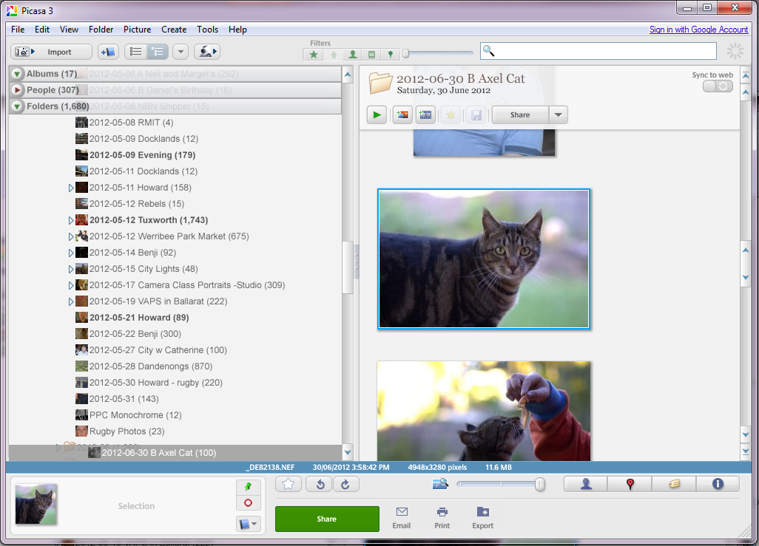
Select you image then check details of your image by clicking in information tab

Slide 5
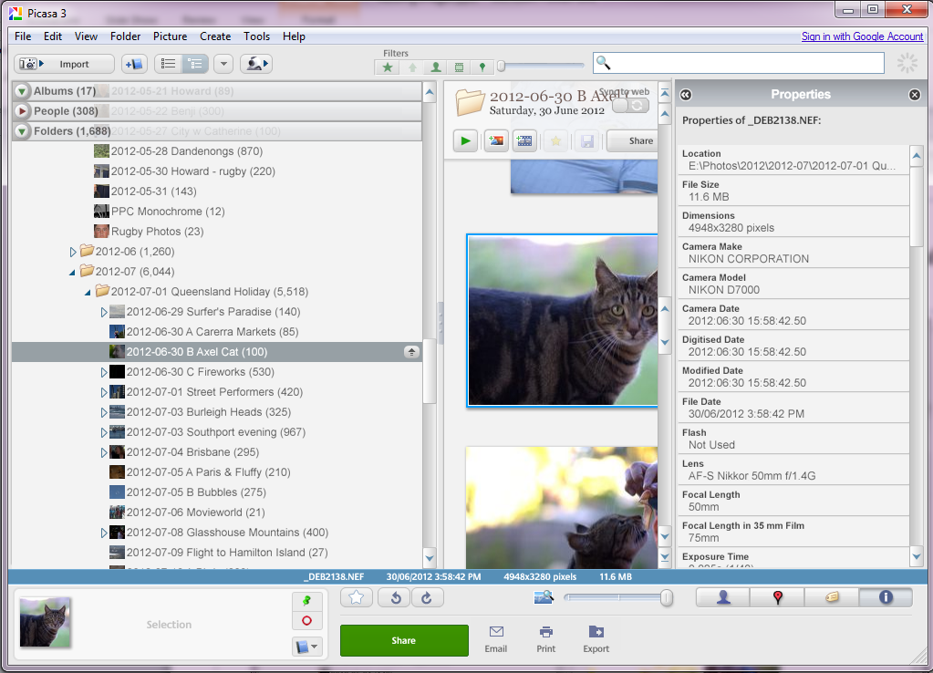
Check file size and dimensions

Slide 6
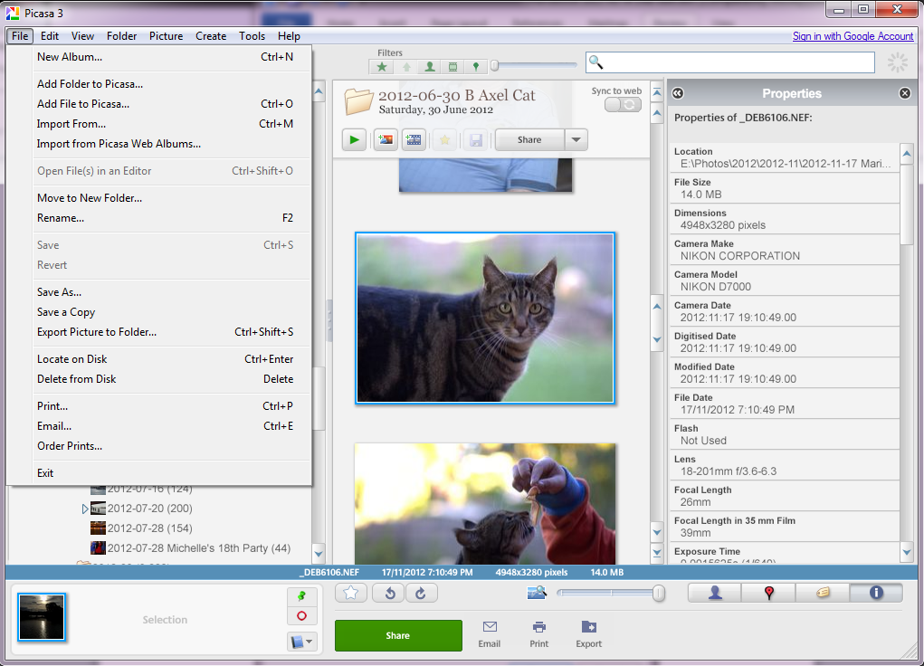
Select rename from the file menu

Slide 7
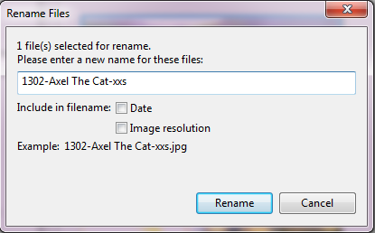
Change the file name and click rename

Slide 8
Now click on export

Slide 9
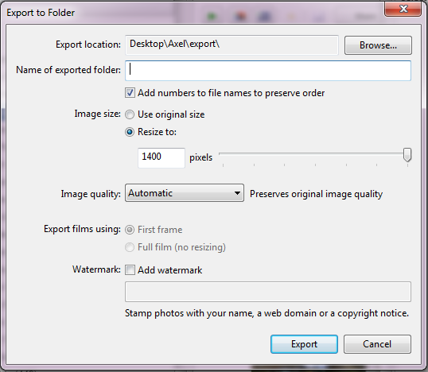
Choose the resize dimension you need.

Slide 10
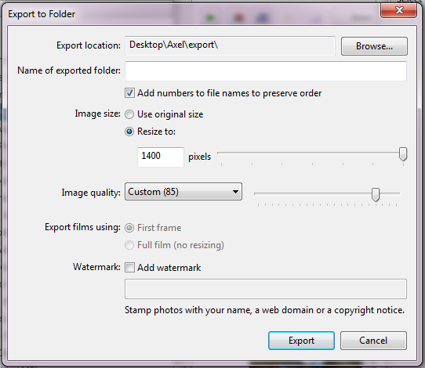
You may also need to reduce quality to get it to size you need. Use the slider to adjust quality. (You may need to redo to end up with the file size you need)

Slide 11
FastStone Image Viewer
Free software
An image browser, converter and editor that supports all major graphic formats including BMP, JPEG, JPEG 2000, GIF, PNG, PCX, TIFF, WMF, ICO, TGA and camera raw files. It has a nice array of features such as image viewing, management, comparison, red-eye removal, emailing, resizing, cropping, color adjustments, musical slideshow and much more.

Slide 12
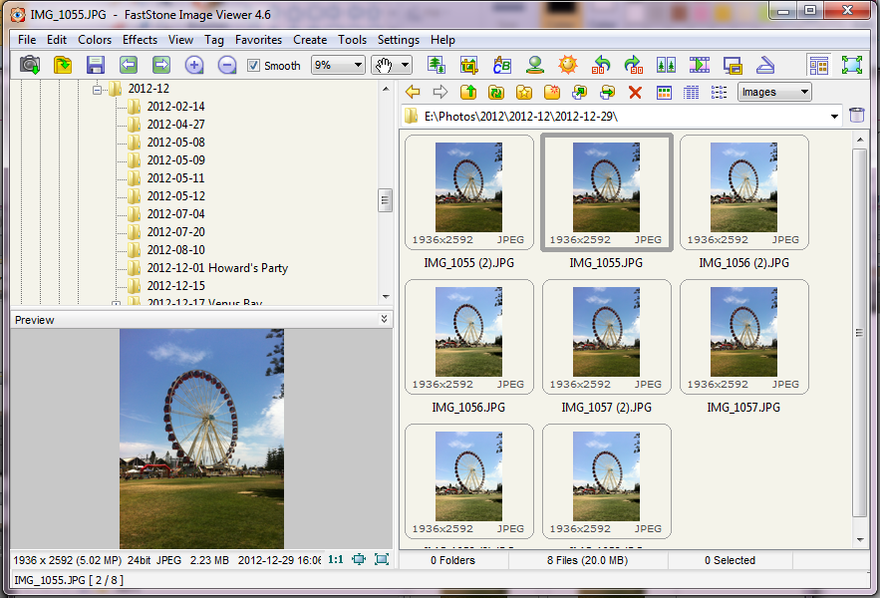
FastStone is free software. Click on the resize/resample icon

Slide 13
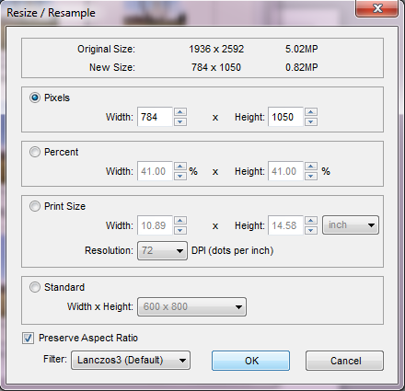
Select pixels to reduce to within 1400 X 1050, check that the new size is less than 1000K (1.0 MP), click OK.

Slide 14
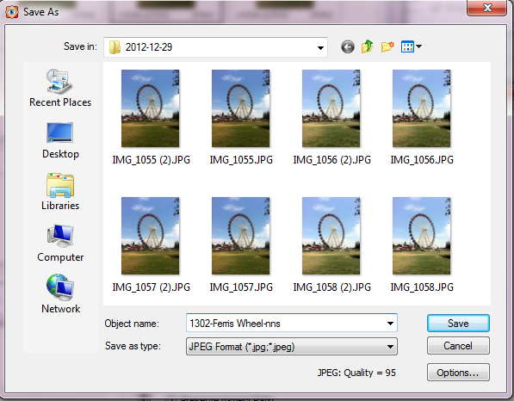
Click on file, save as. Change name, and select JPEG as type. Click on options to review quality and file size.

Slide 15
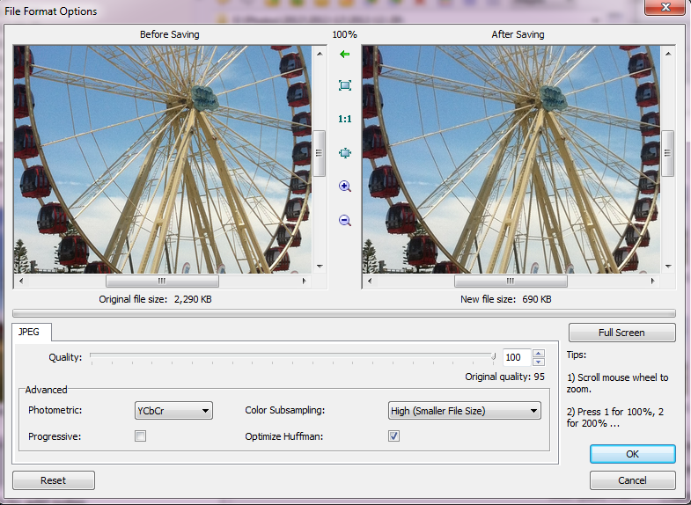
Adjust the quality slider to get the file size < 1000 K click OK, then click save.

Slide 16
Adobe Photoshop Lightroom
Commonly used editing software for photographers

Slide 17
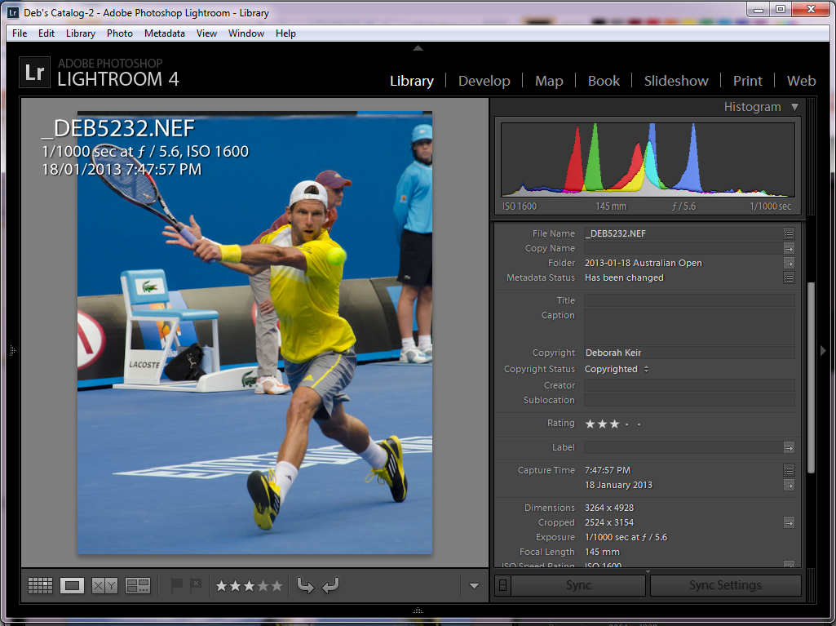
In library module see the image size.

Slide 18
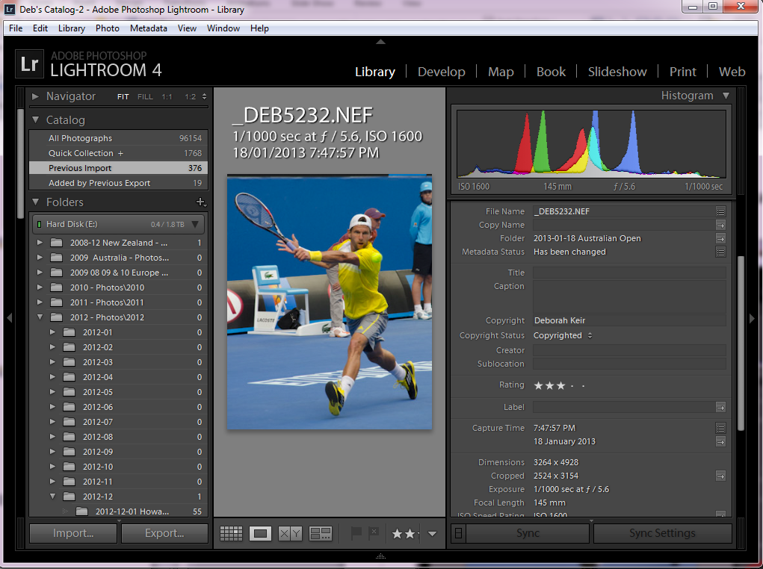
Select export

Slide 19
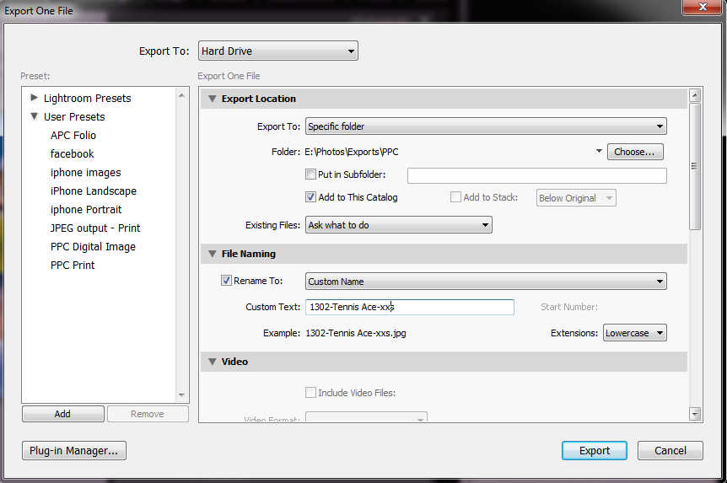
In the export dialog box you can select to rename – select custom name from the list and enter your file name. Then scroll down for more choices.

Slide 20
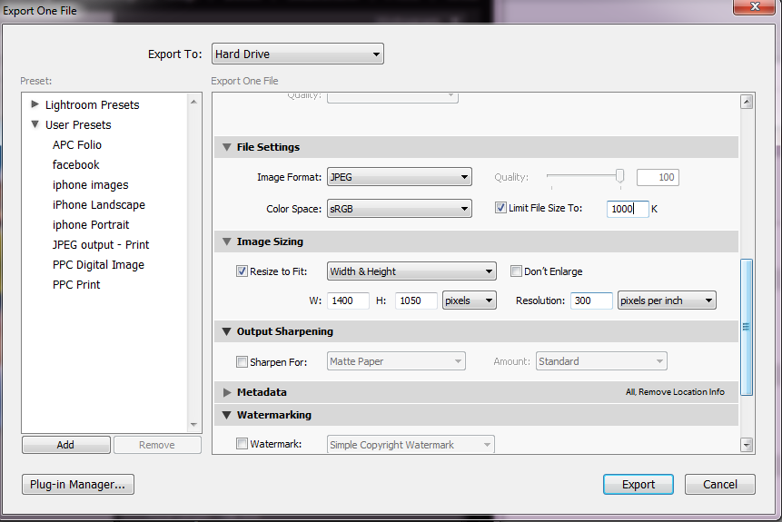
Change the files settings and image sizing before clicking on export. Lightroom will ensure you do not exceed these.

Slide 21
You can set up and use presets for standard formats if you wish.

Slide 22
Photoshop Elements
cutdown version of photoshop that has most editing options suitable for photographers

Slide 23
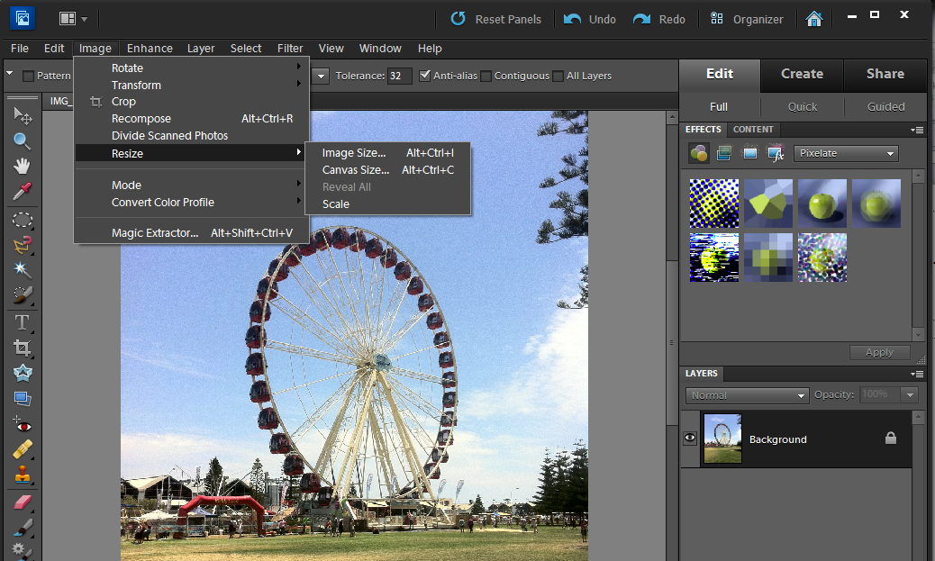
In the image menu – select resize and Image size.

Slide 24
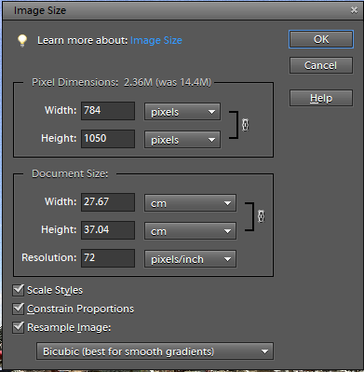
Select the Height and Width so that the image is within 1400 X 1050. Ensure that all the boxes are ticked for best results

Slide 25
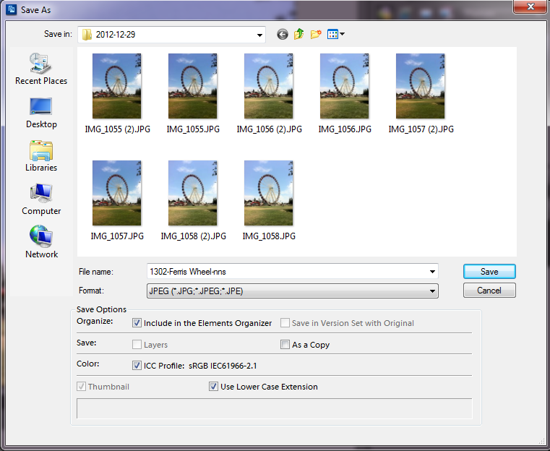
Now select save as from the file menu and enter file name, and select format JPEG, then click on save.

Slide 26
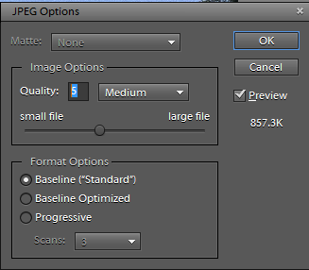
Adjust the quality to ensure that the file size is less than 1000K. Then click OK

Slide 27
Canon Software – Digital Photo Professional
provided when you purchase a canon camera.

Slide 28
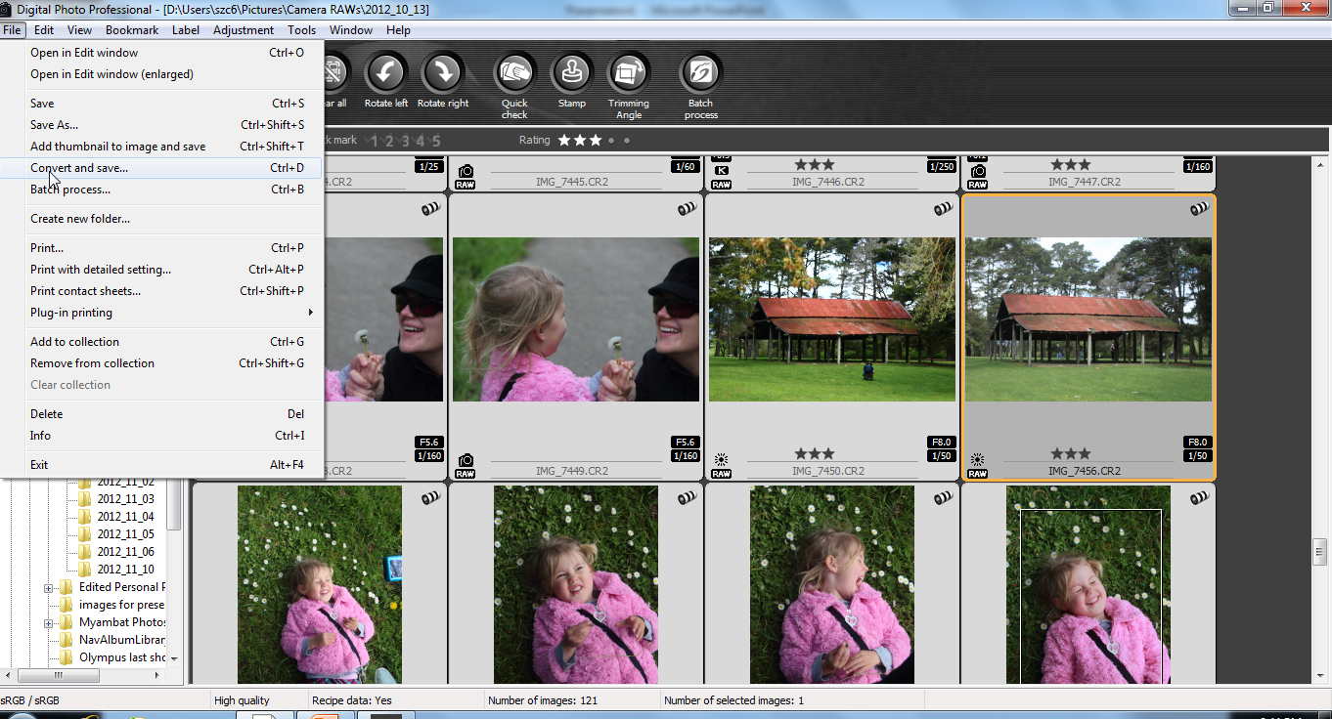
Select the image – select Convert and Save from the File menu

Slide 29
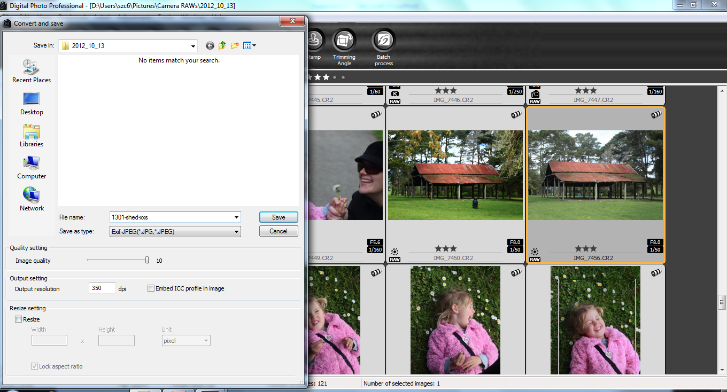
Select your filename, and save as type (JPEG)

Slide 30
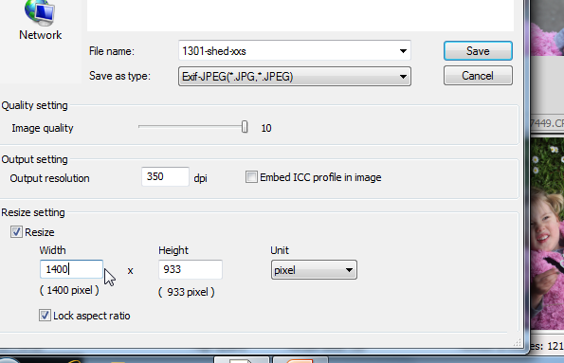
Resize the image (maximum 1400 pixels wide by 1050 pixels high) – make sure the aspect ratio is rocked.

Slide 31
If filesize is too large (>1000 kb) you may need to reduce the image quality.

Slide 32
Printing Options:
Home Printing
Professional Printing

Slide 33
Preparing Prints:
Maximum print size is 40 x 50cms (16 x 20 inches), including mount & matt.
Minimum print size is 10 x 15 cm (4 x 6 inches), excluding mount & matt.
Minimum matt/mount size is 20 x 25cm (8 x 10 inches).
Maximum thickness of entry is 5mm, including matt, print and backing
All prints may be produced either commercially or by member.
Prints must be presented on a cardboard mount board and may only be backed by cardboard or foam core. Members may not submit prints that may potentially damage other entries when packed or during transport.
Prints shall be labelled with the Image Title, the member number and “novice” or “standard” in the top left corner of the image on the reverse side of the mount board. Entries bearing the name of the member will be disallowed for competition.
All mount backings with multiple stickers will not be accepted.

Slide 34
The mount and print sizes match VAPS competition rules, and are limited to allow audience to see print at meeting and also allow sending of prints to judges.
Maximum Mount size 40X50cm (16X20 inches)
Minimum Mount size 20X25
Minimum Mount size 20 x 25cm (8 x 10 inches)
Minimum print size
10 x 15 cm (4 x 6 inches)
50cm

Slide 35
Maximum Mount size 40X50cm (16X20 inches)
Unlike digital images longer maximum edge can be either width or height to allow for portrait or landscape format.
Minimum Mount size
20 x 25cm (8 x 10 inches)
M25
50cm

Slide 36
Panoramas can be included

Slide 37
Labels on the top LH corner on the back, if there may be some confusion add an arrow to indicate UP
Title of image
XX standard

